Slide 1
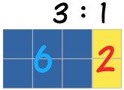
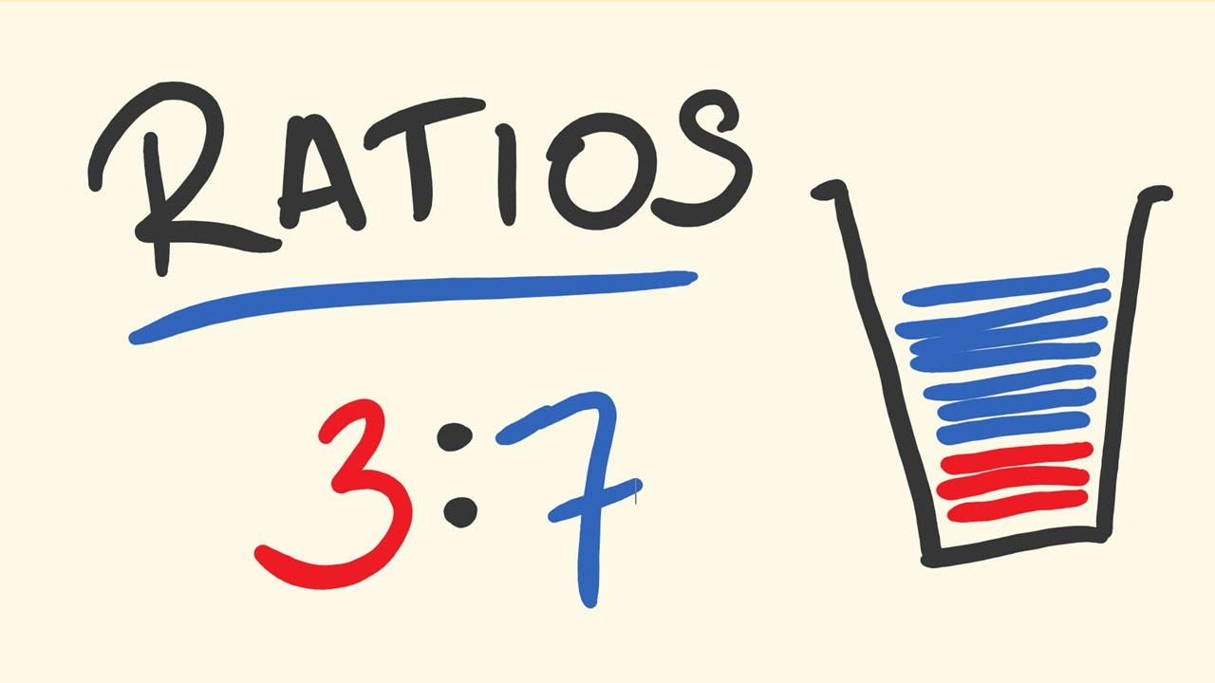
My Proportion Interactive Notebook
Name:
Class: 9-9
Term 2 Semester 1

Slide 2
Warm Up
Find the Highest Common Factor (HCF) of the following:
9 and 12
16 and 18
4 and 20
45 and 54

Slide 3
24
7
30
Date
Direct Proportion
EQ – How can I use direct proportion in my life?
What is direct proportion?
Direct proportion means an increase in one quantity will
cause a similar increase in another quantity.

Slide 4
24
7
30
Date
Direct Proportion
EQ – How can I use direct proportion in my life?
What is direct proportion?
How can I tell if something is
Direct proportion means an increase in one quantity will
cause a similar increase in another quantity.
The direction proportion test: Double one quantity and the
other quantity will double.

Slide 5
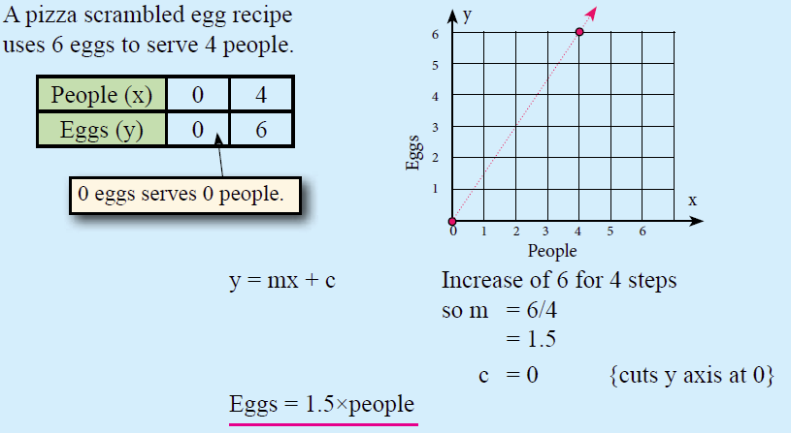
Does this look like how we converted tables to formulae????

Slide 6
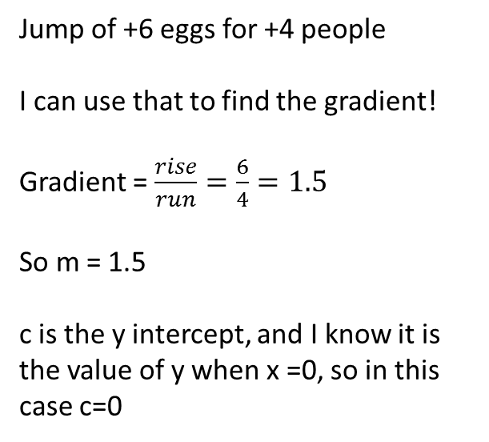
Jump of +6 eggs for +4 people
I can use that to find the gradient!
Gradient = $\frac{rise}{run}=\frac{6}{4}=1.5$
So m = 1.5
c is the y intercept, and I know it is the value of y when x =0, so in this case c=0

Slide 7
Wow, this is all related! #crazy

Slide 8
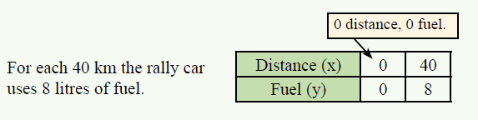
Work this example together

Slide 9
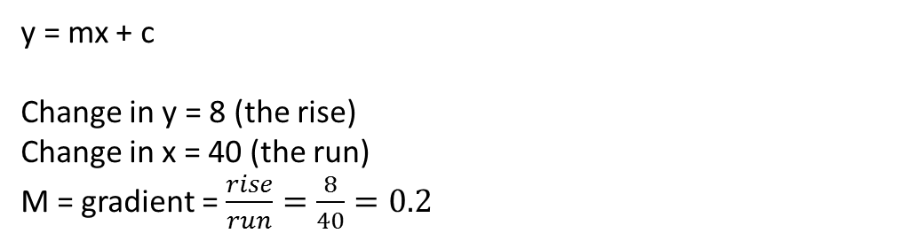
Work this example together
y = mx + c
Change in y = 8 (the rise)
Change in x = 40 (the run)
M = gradient = $\frac{rise}{run}=\frac{8}{40}=0.2$

Slide 10
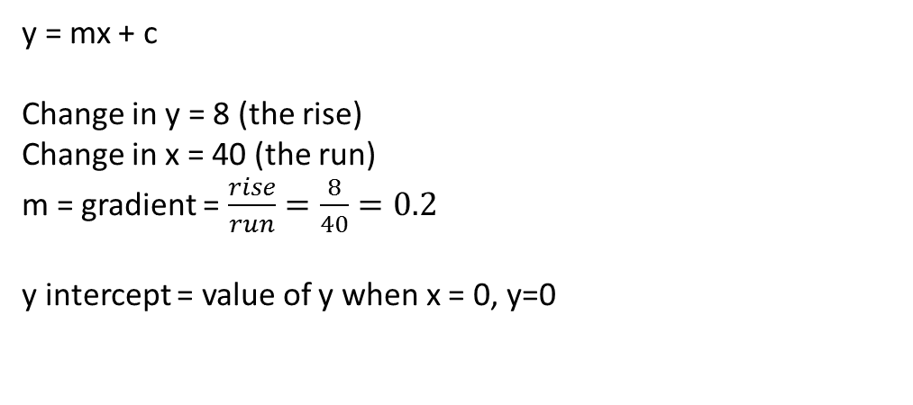
Work this example together
y = mx + c
Change in y = 8 (the rise)
Change in x = 40 (the run)
m = gradient = $\frac{rise}{run}=\frac{8}{40}=0.2$
y intercept = value of y when x = 0, y=0

Slide 11
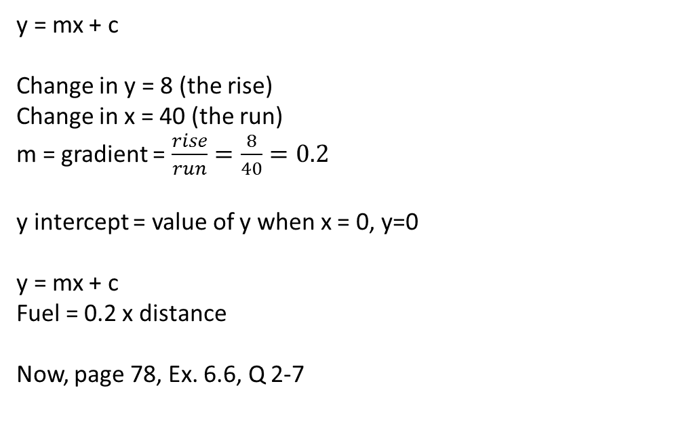
Work this example together
y = mx + c
Change in y = 8 (the rise)
Change in x = 40 (the run)
m = gradient = $\frac{rise}{run}=\frac{8}{40}=0.2$
y intercept = value of y when x = 0, y=0
y = mx + c
Fuel = 0.2 x distance
Now, page 78, Ex. 6.6, Q 2-7

Slide 12
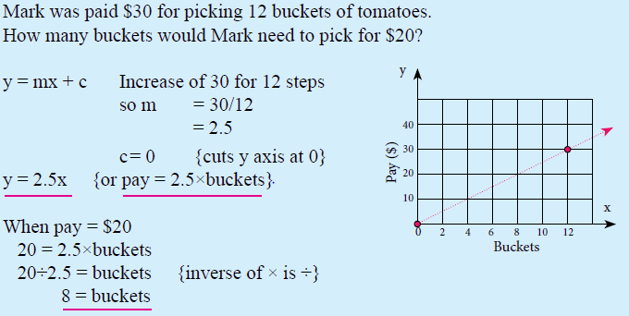
Just like before
y = mx + c
y = 2.5x
Now we substitute in y = 20 to work out the value of x

Slide 13
Now lets work on page 78, Ex. 6.6, Q 2-7

Slide 14
Complete your Summary ensuring you explain the process of using direct proportions and how you will apply it in your life.

Slide 15
Notes Review
24, 7 ,30
Date
Title
Essential question
Notes complete
Notes complete with colour and diagrams
Questions completed
Contents page filed in
Formula page filled in

Slide 16
Homework
Review your notes and write a summary answering the essential question.
Ex 6.6, 6.7

